Slide 1
Project Presentation On “Flight Price Prediction”
Submitted By
SAKSHI SHUKLA

Slide 2
Agenda:
Overview.
Problem Statement.
Problem Understanding.
What is Flight Price Prediction?
Importance of Flight price prediction.
Exploratory data analysis.
Visualizations.
Analysis.
Data cleaning steps.
Model Building.
Hyper Parameter Tunning.
Saving the model and predictions from saved best model.
Conclusion.

Slide 3
Overview:
In this particular presentation we will be looking on:
How to analyze the dataset of Flight Price Prediction.
What are the EDA steps in cleaning the dataset.
Overall analysis on the problem.
Model building from cleaned dataset.
Predicting Flight Price for saved best model.

Slide 4
Problem Statement:
Anyone who has booked a flight ticket knows how unexpectedly the prices vary. The cheapest available ticket on a given flight gets more and less expensive over time. This usually happens as an attempt to maximize revenue based on –
1. Time of purchase patterns (making sure last-minute purchases are expensive)
2. Keeping the flight as full as they want it (raising prices on a flight which is filling up in order to reduce sales and hold back inventory for those expensive last-minute expensive purchases)
So, you have to work on a project where you collect data of flight fares with other features and work to make a model to predict fares of flights.

Slide 5
Problem Understanding:
Flight prices are something unpredictable. It’s more than likely that we spent hours on the internet researching flight deals, trying to figure an airfare pricing system that seems completely random every day. Flight price appears to fluctuate without reason and longer flights aren’t always more expensive than shorter ones.
But now the question is how to know proper Flight price, for that I have built a Machine learning model which can predict the Flight price. Using various features like Airline, Source, Destination, Arrival time, Departure time, Stops, Travelling date and the Price for the same travel. So using all these previously known information and analysing the data I have achieved a good model that has 82% accuracy. So let’s understand what all the steps we did to reach this good accuracy.

Slide 6
What is Flight Price Prediction?
Nowadays, the number of people using flights has increased significantly. It is difficult for airlines to maintain prices since prices change dynamically due to different conditions. That’s why we will try to use machine learning to solve this problem. This can help airlines by predicting what prices they can maintain. It can also help customers to predict future flight prices and plan their journey accordingly.

Slide 7
Importance of Flight Price Prediction.
It is hard for the client to buy an air ticket at the most reduced cost. For this few procedures are explored to determine time and date to grab air tickets with minimum fare rate. The majority of these systems are utilizing the modern computerized system known as Machine Learning. The model guesses airfare well in advance from the known information. This framework is proposed to change various added value arrangements into included added value arrangement heading which can support to solo gathering estimation.

Slide 8
Exploratory Data Analysis:
As a first step I have scrapped the required data using selenium from makemytrip website.
And I have imported required libraries and I have imported the dataset which was in csv format.
Then I did all the statistical analysis like checking shape, nunique, value counts, info etc…..
While checking for null values I found there was a row full of null values in the dataset and I dropped that row as it will not help our analysis.
I have also droped Unnamed:0 column as I found it was the index column of csv file.
Next as a part of feature extraction I converted the data types of datetime columns and I have extracted usefull information from the raw dataset. Thinking that this data will help us more than raw data.

Slide 9
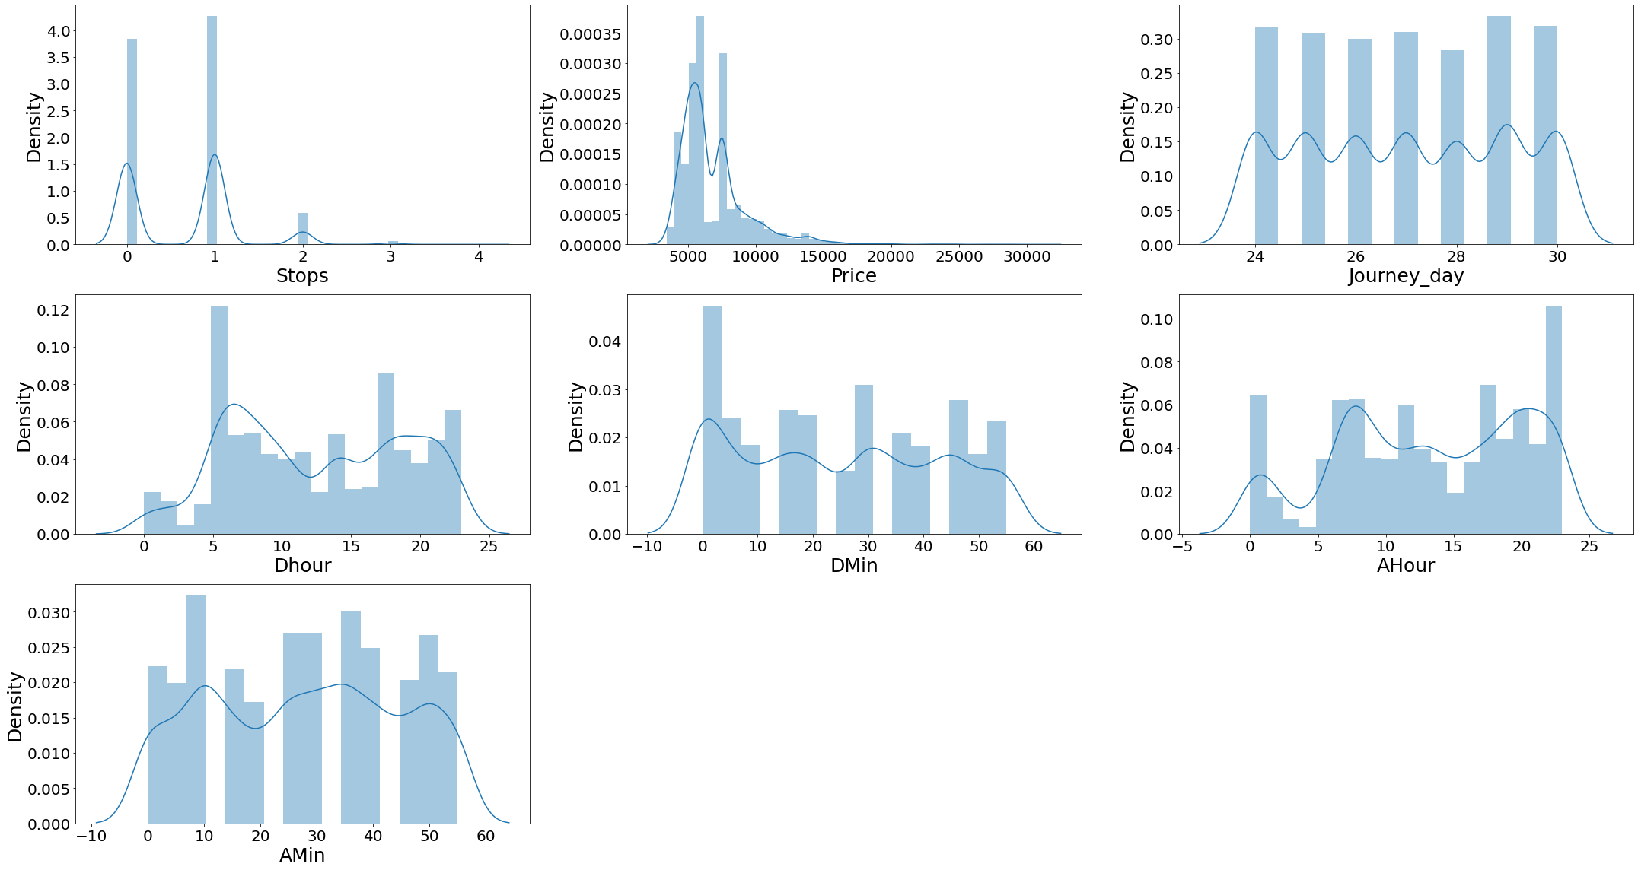
Univariate Visualization of numerical columns:

Slide 10
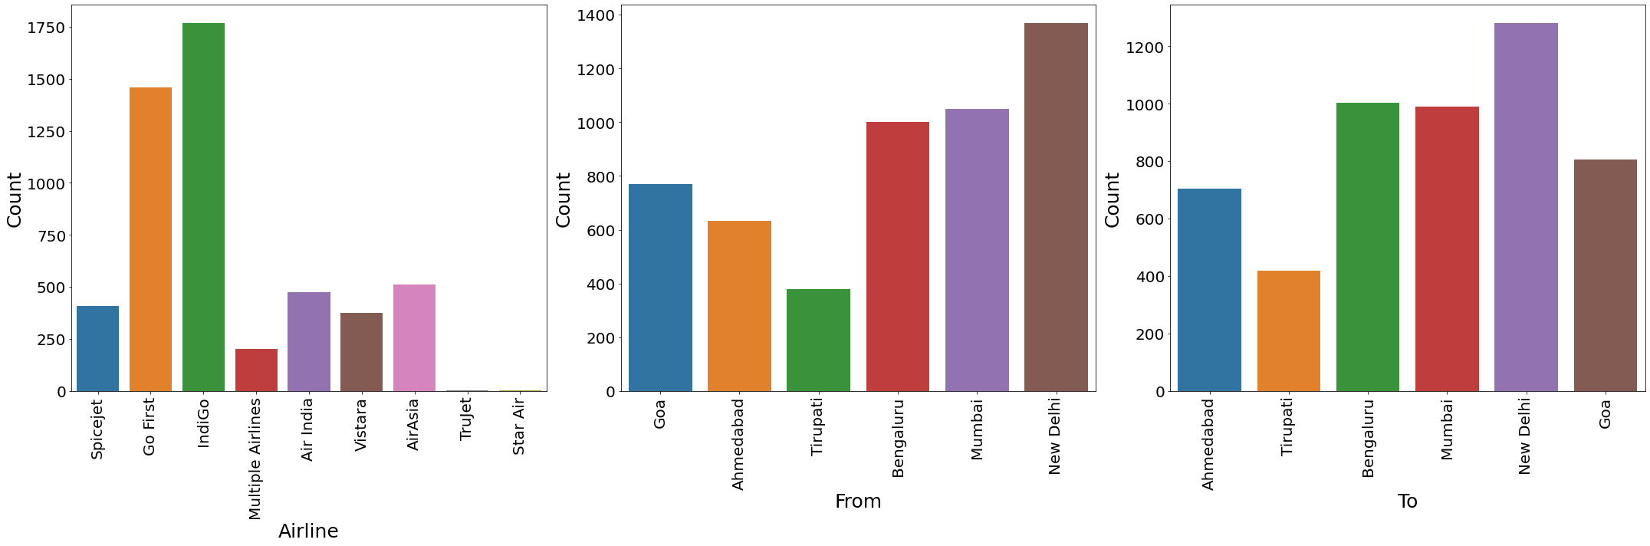
Univariate Vizualization of Categorical columns:

Slide 11
Observations:
Univariate numerical columns:
There is no skewness in any of the numerical columns.
Univariate categorical columns:
Indigo has maximum count which means most of the passengers preferred Indigo for there travelling.
New Delhi has maximum count for source which means maximum passengers are choosing New Delhi as there source.
New Delhi has maximum count for Destination which means maximum passengers are choosing New Delhi as there Destination.

Slide 12
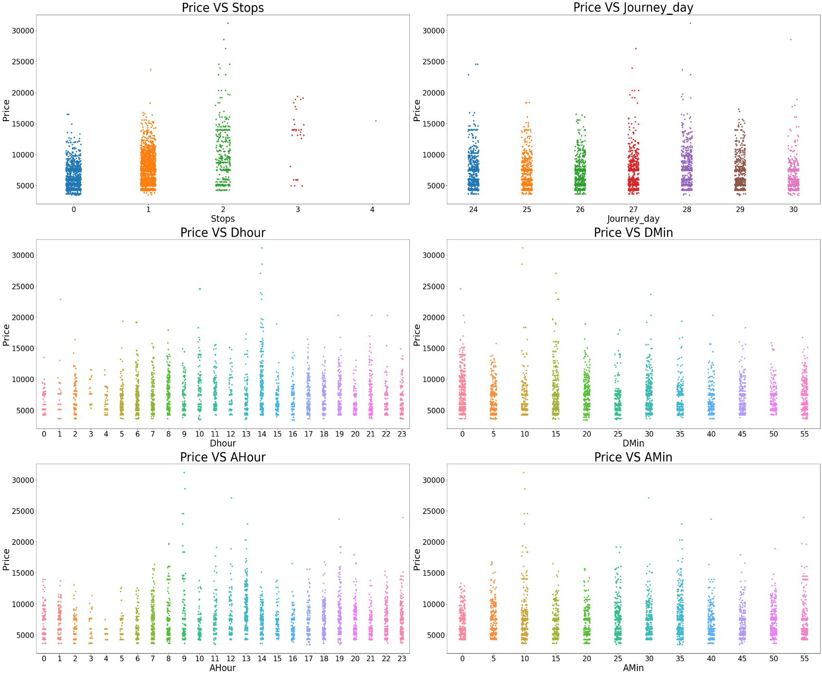
Bivariate Vizualization of numerical columns:

Slide 13
Observations:
Flights with 2 stops costs more price compared to other flights.
In all the dates the price is almost same.
At 2PM departure time of every day the flight Prices are high so it looks good to book flights rather than this departure time.
And Departure minute has less relation with target Price.
At 7AM to 1PM Arrival time of every day the flight Prices are high so it looks good to book flights rather than this arrival time.
And Arrival minute has less relation with target Price.

Slide 14
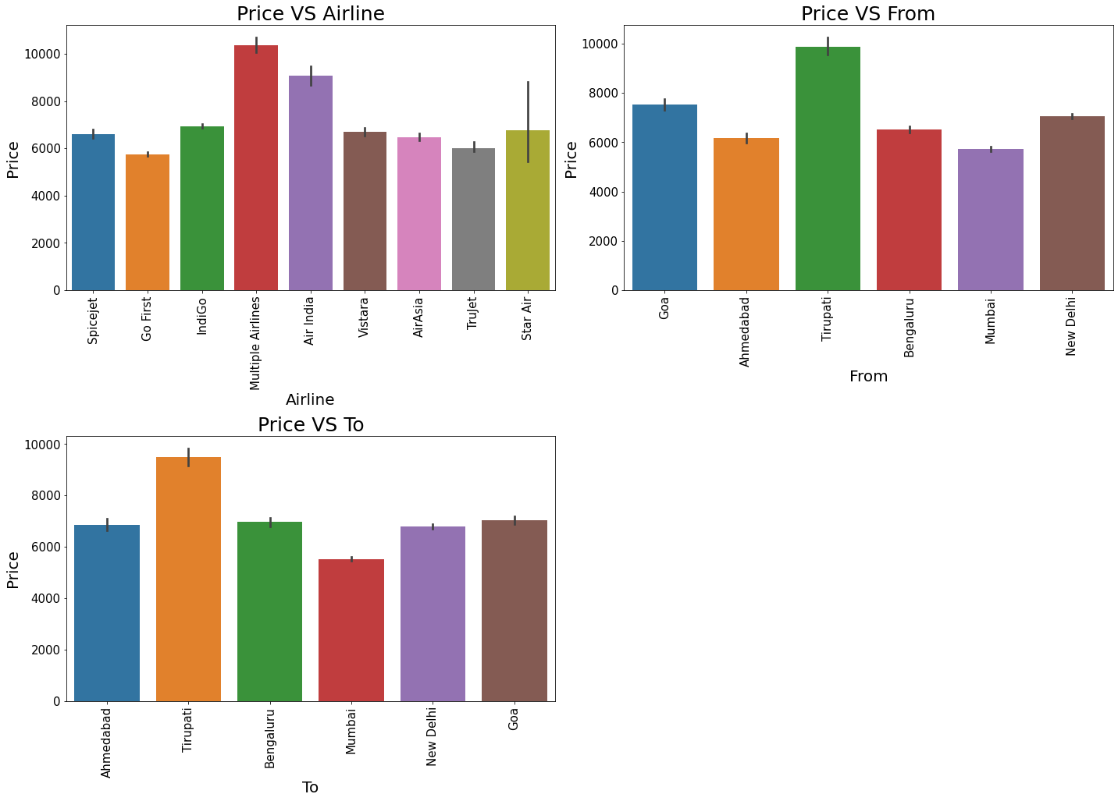
Bivariate Vizualization of categorical columns:

Slide 15
Observations:
For Multiple Airlines the Price is high compared to other Airlines.
Taking Tirupati as Source costs highest Price Compared to other Source points.
Taking Tirupati as Destination costs highest Price Compared to other Destination points.

Slide 16
Analysis:
I have used dist plot to check the skewness in numerical columns.
I have used bar plot for each of categorical feature that shows the relation with the median flight price for all the sub categories in each categorical feature.
And also for continuous numerical variables I have used strip to show the relationship between continuous numerical variable and target variable.
I found that there is a linear relationship between continuous numerical variable and Flight Price.

Slide 17
Data Cleaning Steps:
Data has been scrapped from makemytrip website so we have to clean it for our convenience.
In my datasets I found there is no null values, outliers and also skewness.
To encode the categorical columns I have use Label Encoding.
Use of Pearson’s correlation coefficient to check the correlation between dependent and independent features.
Also I have used standardization. Then followed by model building with all regression algorithms.

Slide 18
Model Building:
Since Price was my target and it was a continuous column with improper format which has to be changed to continuous float datatype column, so this perticular problem was Regression problem. And I have used all Regression algorithms to build my model. By looking into the r2 score and error values I found ExtraTreesRegressor as a best model with highest r2_score and least error values. Also to get the best model we have to run through multiple. Below are the list of Regression algorithms I have used in my project.
RandomForestRegressor
XGBRegressor
ExtraTreesRegressor
GradientBoostingRegressor
DecisionTreeRegressor
KNN
BaggingRegressor

Slide 19
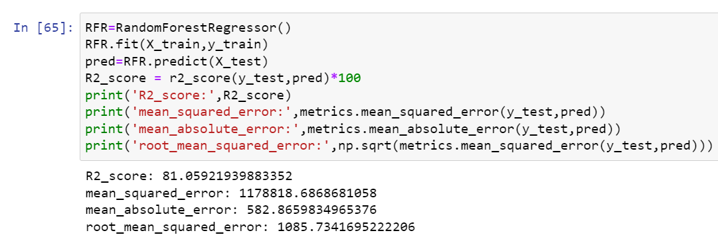
i) RandomForestRegressor:
RandomForestRegressor has given me 81.05% r2_score, but still we have to look into multiple models.

Slide 20
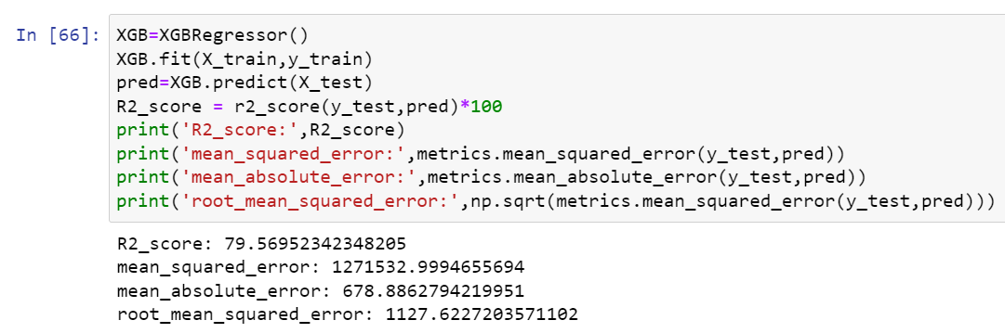
ii) XGBRegressor:
XGBRegressor is giving me 79.60% r2_score.

Slide 21
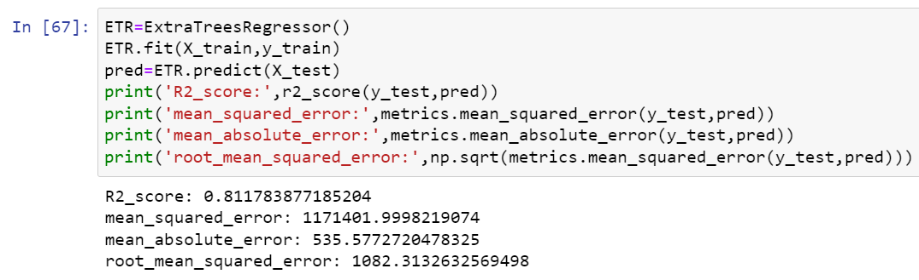
iii)ExtraTreesRegressor:
ExtraTreesRegressor is giving me 81.18% r2_score.

Slide 22
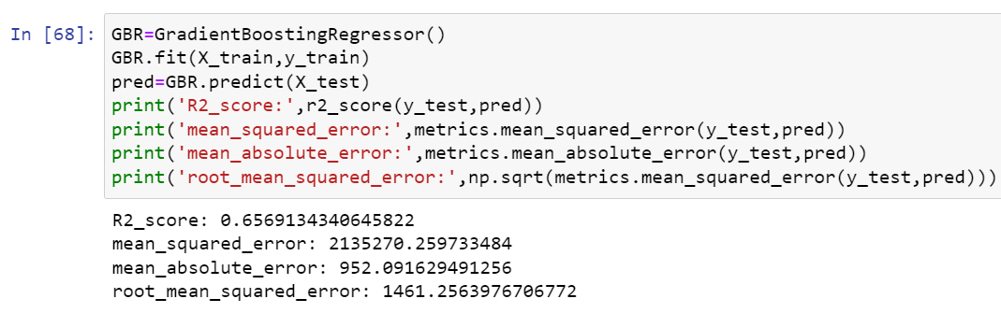
iv) GradientBoostingRegressor:
GradientBoostingRegressor is giving me 65.69% r2_score.

Slide 23
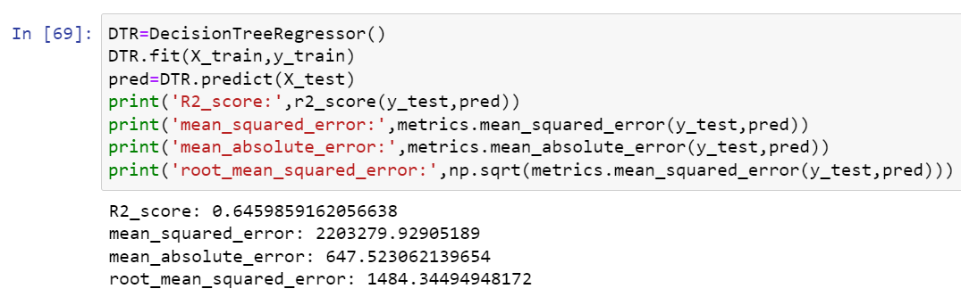
v) DecisionTreeRegressor:
DecisionTreeRegressor is giving me 64.60% r2_score.

Slide 24
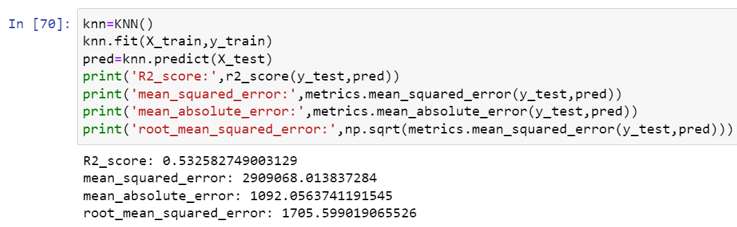
vi) KNN:
KNN is giving me 53.25% r2_score.

Slide 25
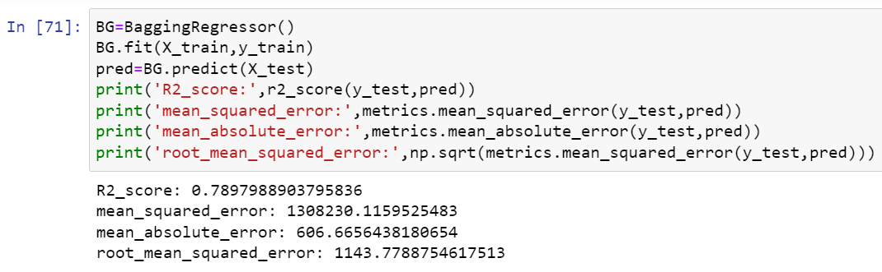
vii) BaggingRegressor:
BaggingRegressor is giving me 78.98% r2_score.
By looking into the model r2_score and error I found ExtraTreesRegressor as the best model with highest r2_score and least errors.

Slide 26
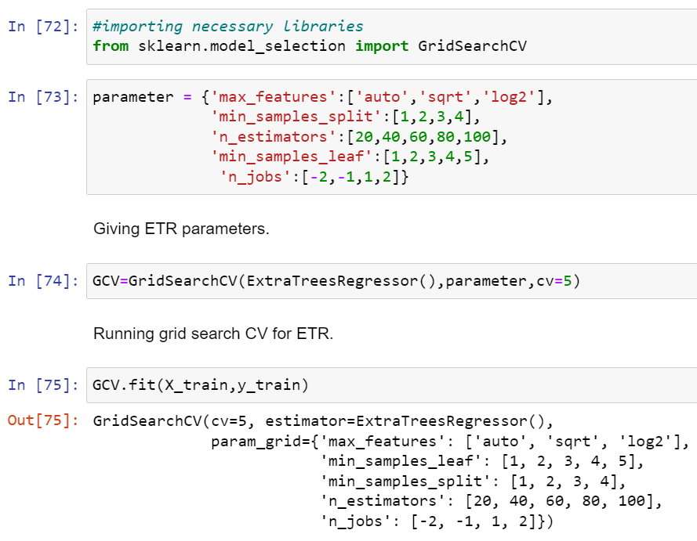
Hyper Parameter Tunning:

Slide 27
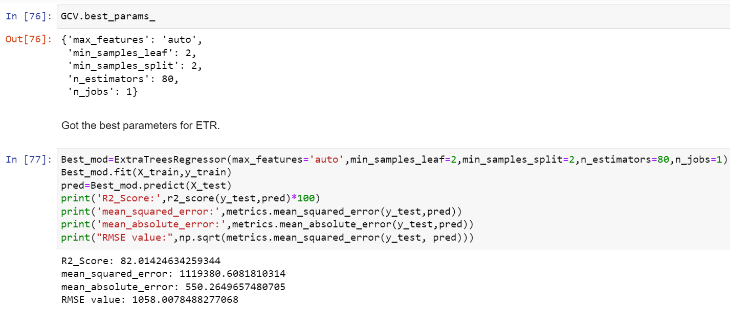
Hyper Parameter Tunning:
I have chosen all parameters of ExtraTreesRegressor, after tunning the model with best parameters I have increased my model accuracy from 81.18% to 82.01%.

Slide 28
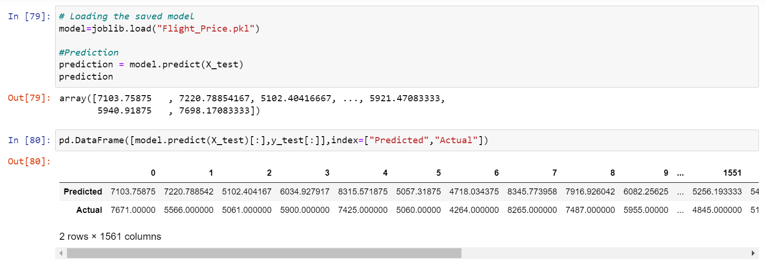
Saving the model and predictions using saved model:
I have saved my best model using .pkl as follows.
Now after saving the best model, loading my saved model and predicting the price values.
I have predicted the Flight Price using saved model, and the predictions look good. The Predicted values are almost same as actual values.

Slide 29
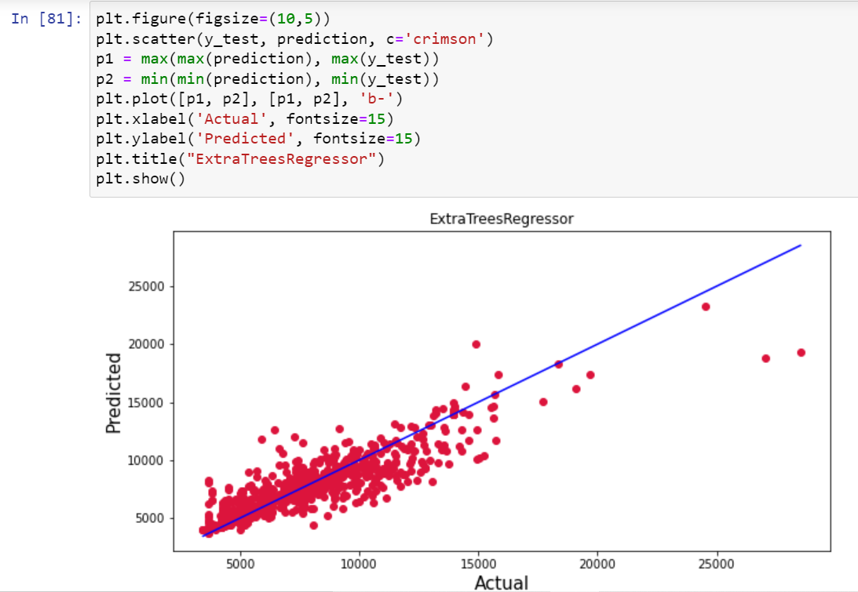
Ploting the predicted values v/s actual values:
Plotting Actual vs Predicted, To get better insight. Bule line is the actual line and red dots are the predicted values.

Slide 30
Conclusion:
In this project report, we have used machine learning algorithms to predict the flight price. We have mentioned the step by step procedure to analyze the dataset and finding the correlation between the features.
Thus we can select the features which are correlated to each other and are independent in nature. The power of visualization has helped us in understanding the data by graphical representation it has made me to understand what data is trying to say.
Data cleaning is one of the most important steps to remove unrealistic values and unnecessary values.
These feature set were then given as an input to seven algorithms and a hyper parameter tunning was done to the best model and the accuracy has been improved. Hence we calculated the performance of each model using different performance metrics and compared them based on these metrics.
Then we have also saved the best model and predicted the flight price. It was good that the predicted and actual values were almost same.
To conclude, the application of machine learning in flight price prediction is still at an early stage. We hope this study has moved a small step ahead in providing some methodological and empirical contributions to online platforms, and presenting an alternative approach to the valuation of flight price.
Future direction of research may consider incorporating additional flight data from a larger economical background with more features.

